Slide 1
Data Visualizations

Slide 2
Why do we need visualizations

Slide 3
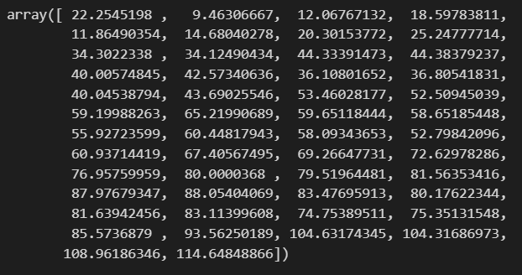
Before

Slide 4
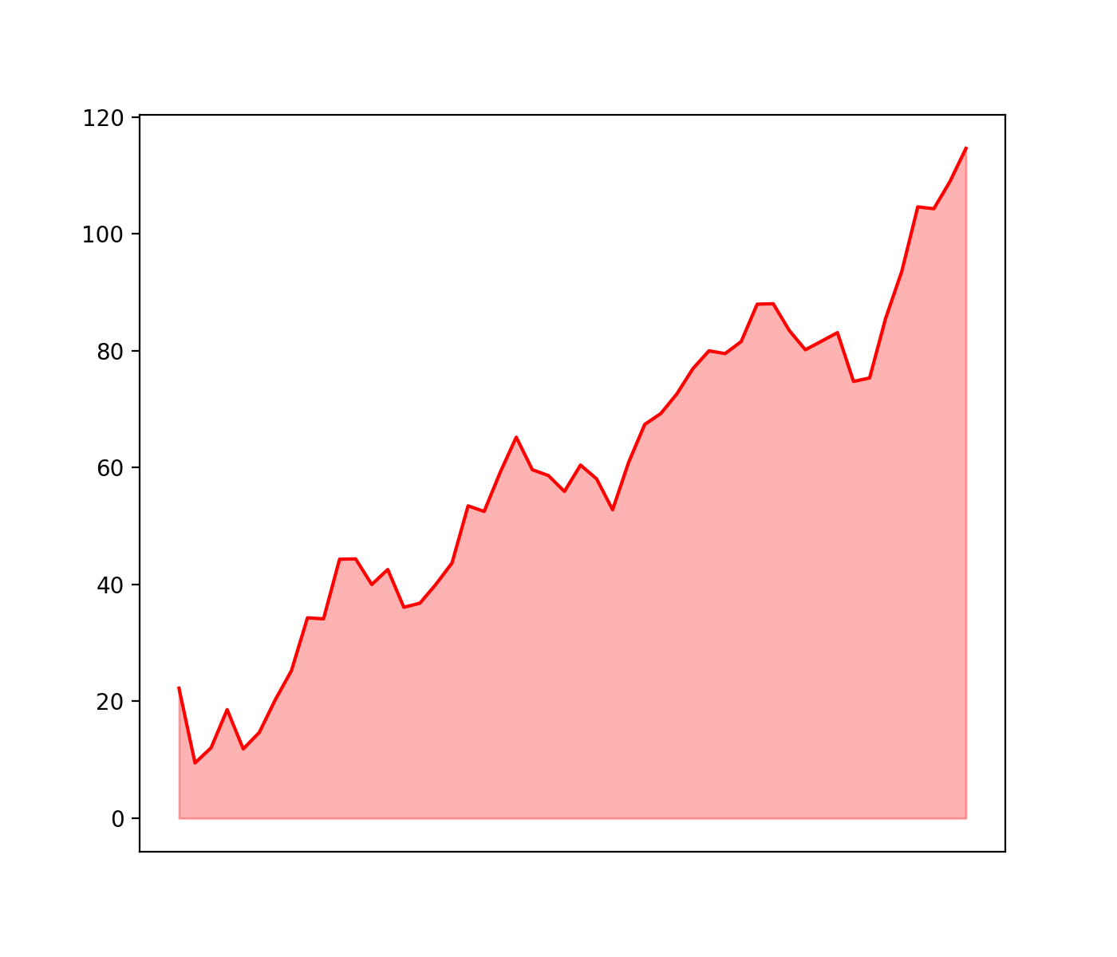
After

Slide 5
Main libraries

Slide 6
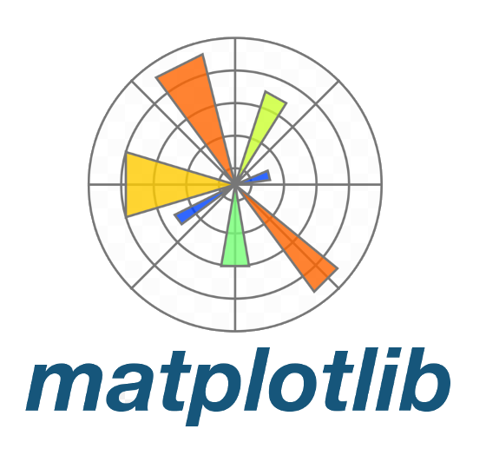
Main libraries
Fundamental

Slide 7

Main libraries
Fundamental

Slide 8

Main libraries
Fundamental
Interactive

Slide 9
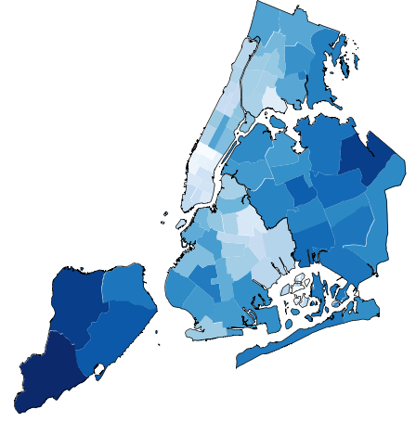
Main libraries
Fundamental
Interactive
Geospatial
Geoplot

Slide 10

Main libraries
Fundamental
Interactive
Geospatial
Geoplot

Slide 11
Other visualization apps

Slide 12



Other visualization apps

Slide 13
How to visualize data distribution

Slide 14
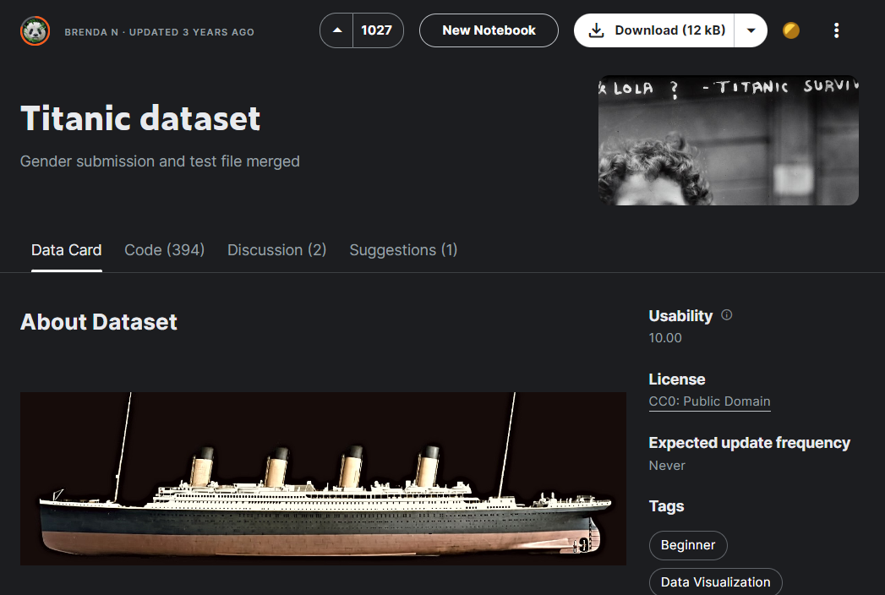

Slide 15
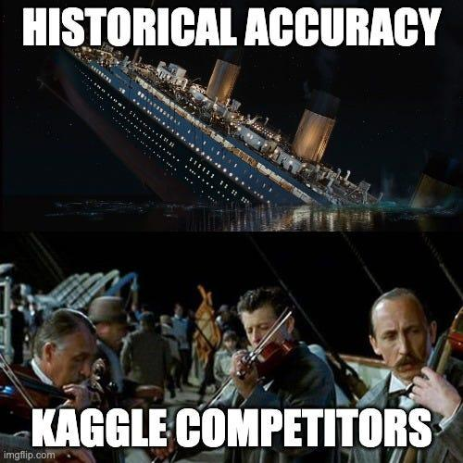

Slide 16
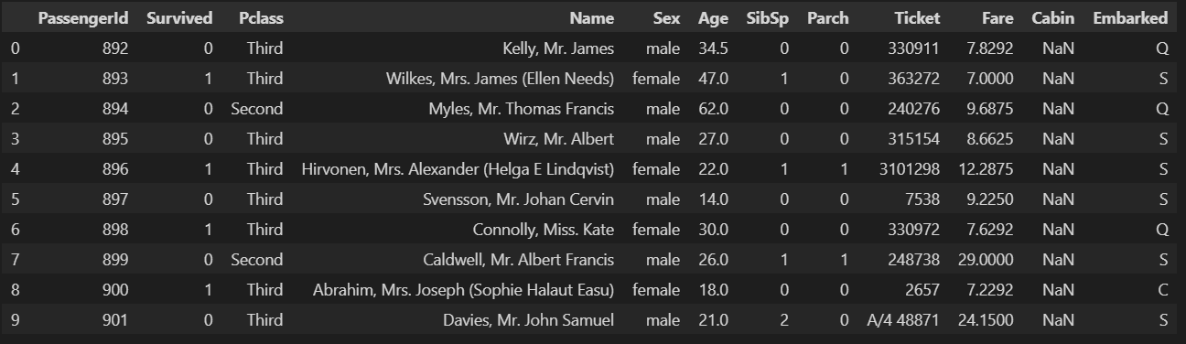

Slide 17
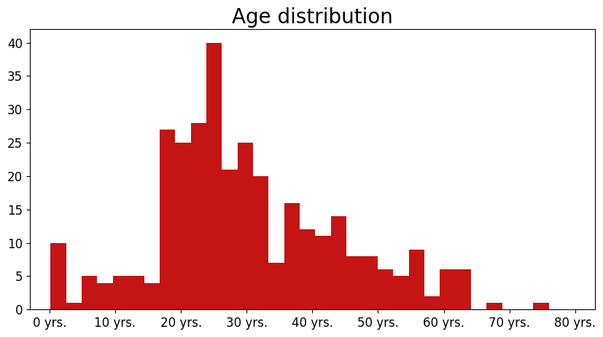
Histogram

Slide 18
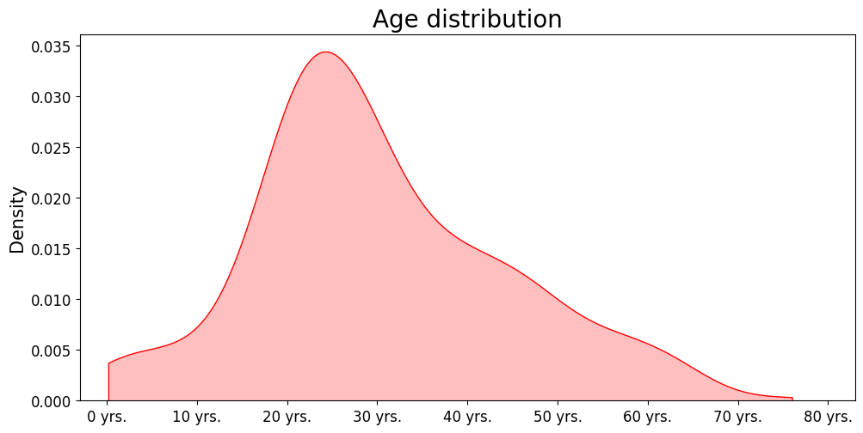
Density plot

Slide 19
KDE

Slide 20
KDE - Kernel Density Estimator

Slide 21

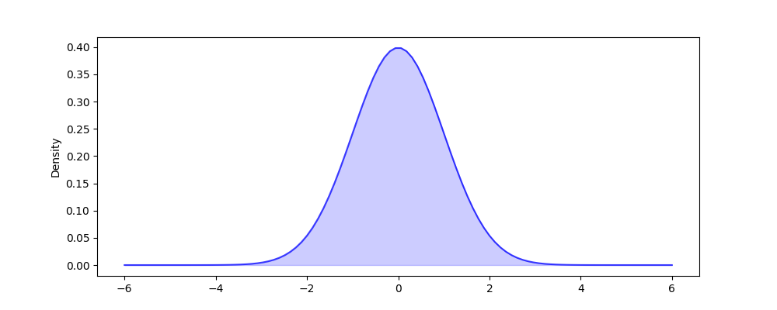
Density plot

Slide 22
Density plot

Slide 23

Density plot

Slide 24
Density plot
h - kernel bandwidth

Slide 25

Density plot
h - kernel bandwidth

Slide 26
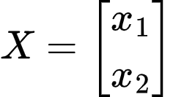
Density plot

Slide 27

Density plot

Slide 28
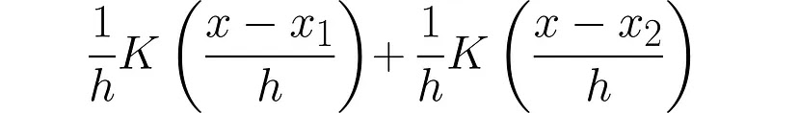
Density plot

Slide 29
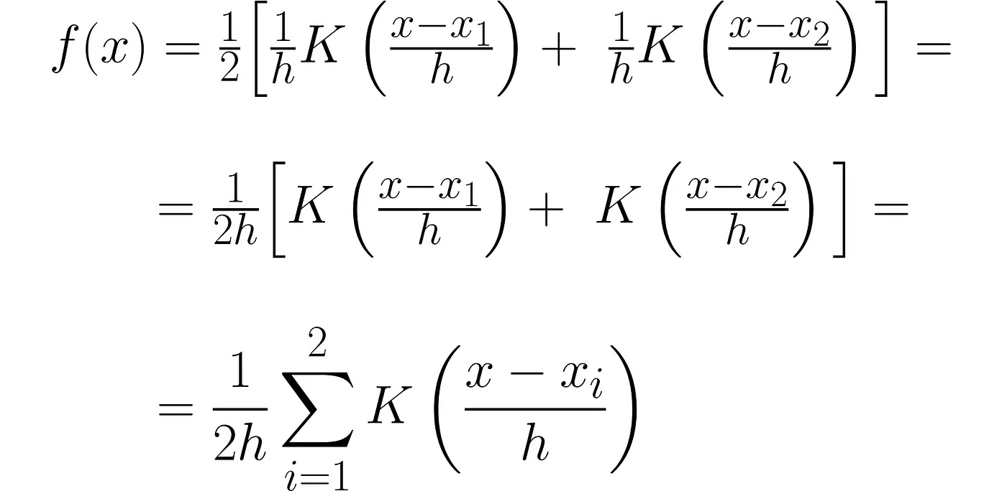
Density plot

Slide 30
Density plot

Slide 31
Density plot

Slide 32
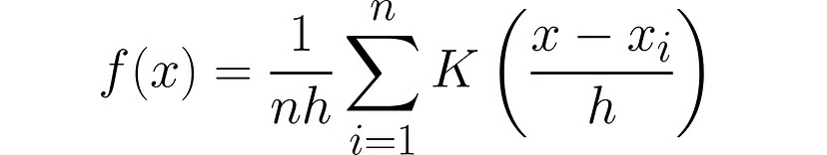
Density plot

Slide 33
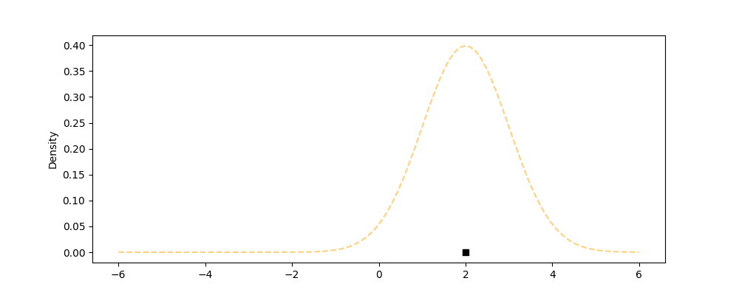
Density plot

Slide 34
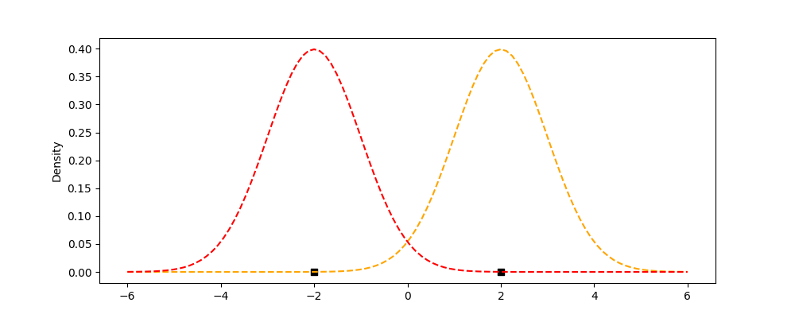
Density plot

Slide 35
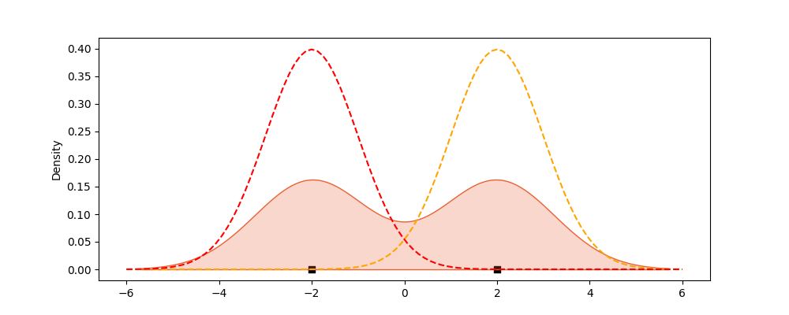
Density plot

Slide 36
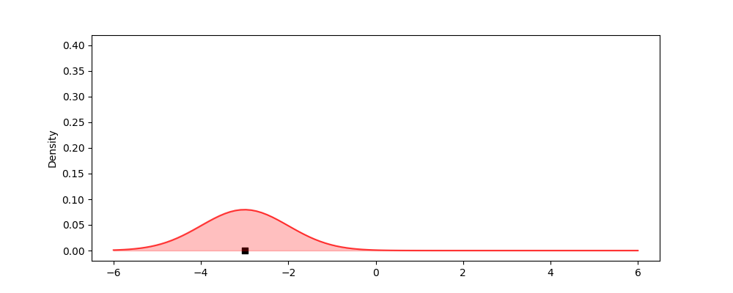
Density plot

Slide 37
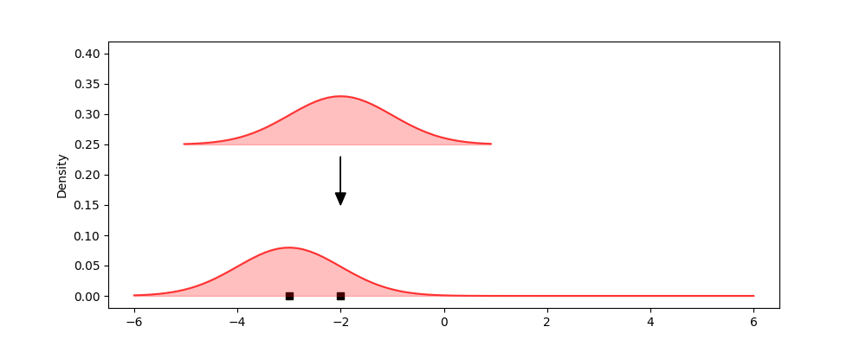
Density plot

Slide 38
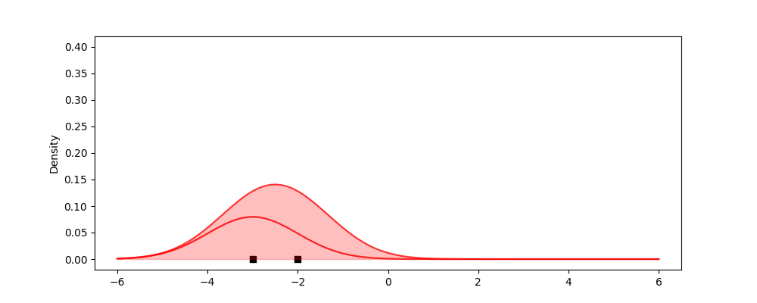
Density plot

Slide 39
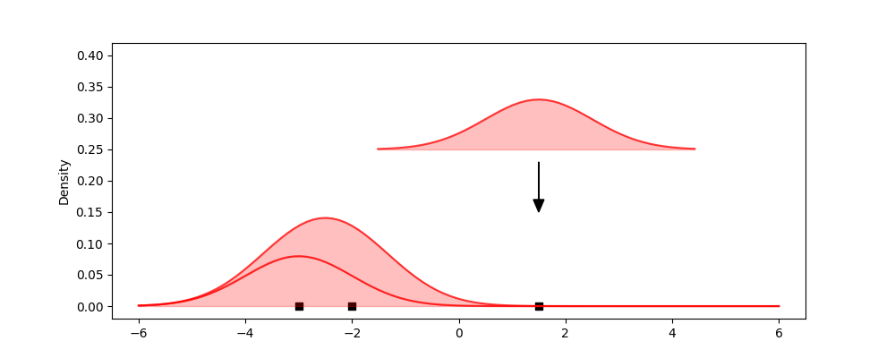
Density plot

Slide 40
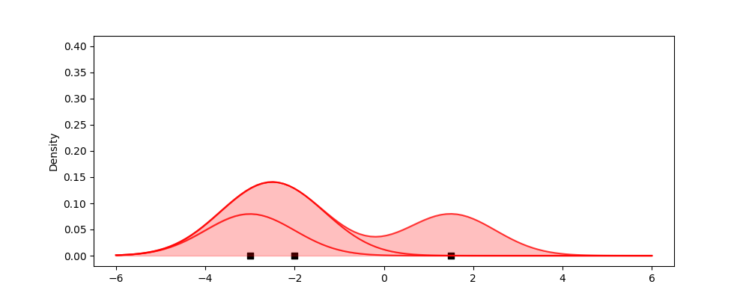
Density plot

Slide 41
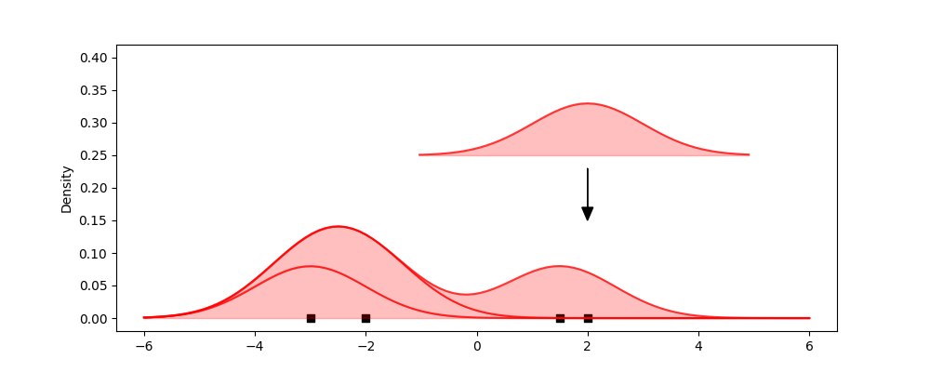
Density plot

Slide 42
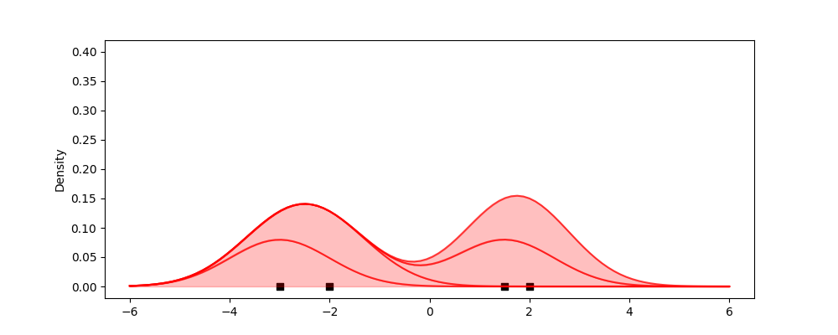
Density plot

Slide 43
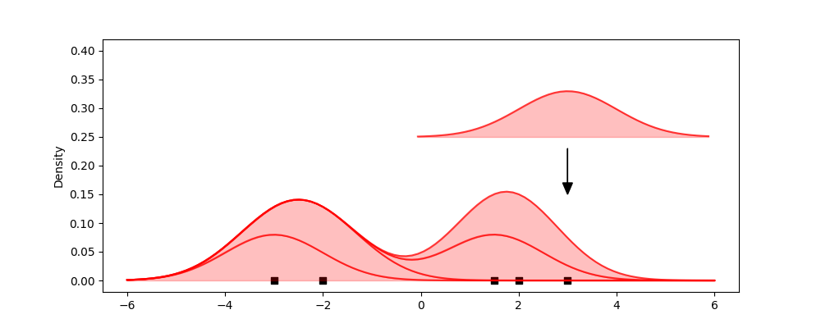
Density plot

Slide 44
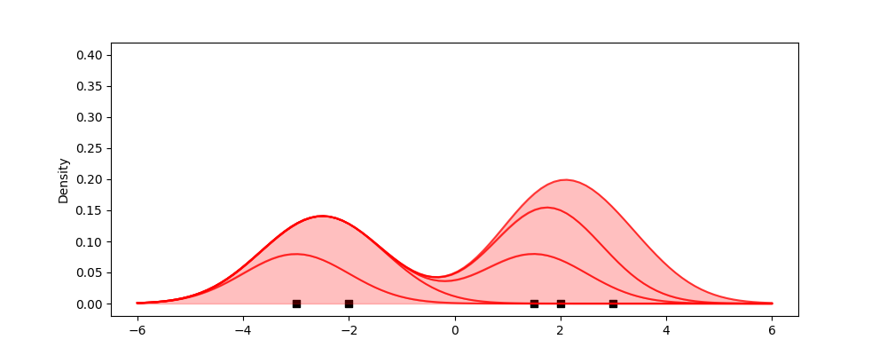
Density plot

Slide 45
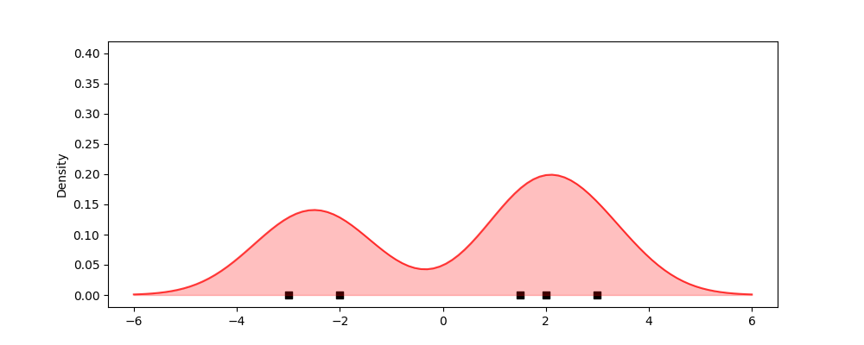
Density plot

Slide 46
Comparing multiple distributions

Slide 47
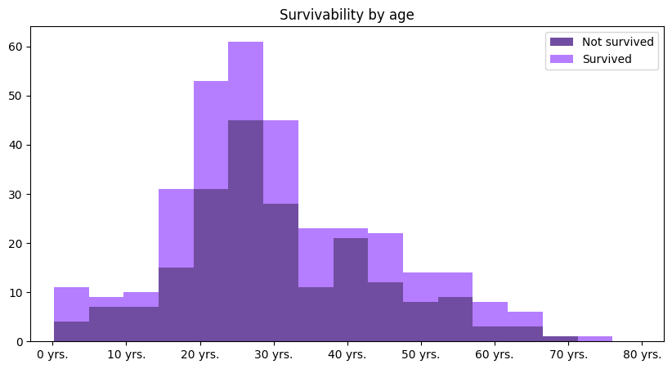
Stacked histogram

Slide 48
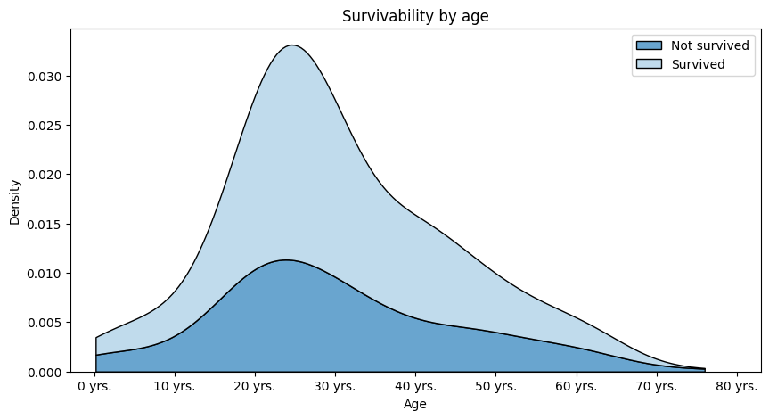
Stacked density plot

Slide 49
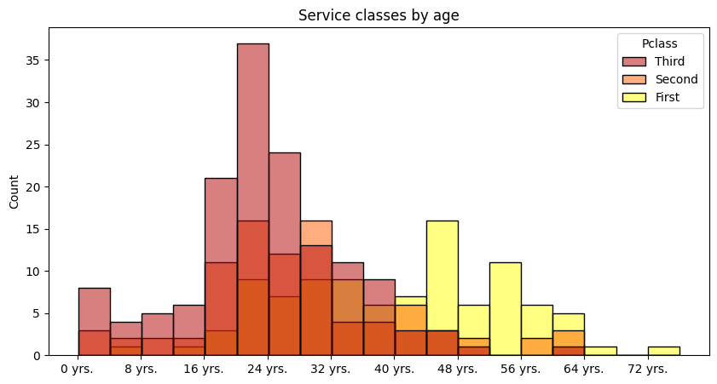
Overlaping density plot

Slide 50
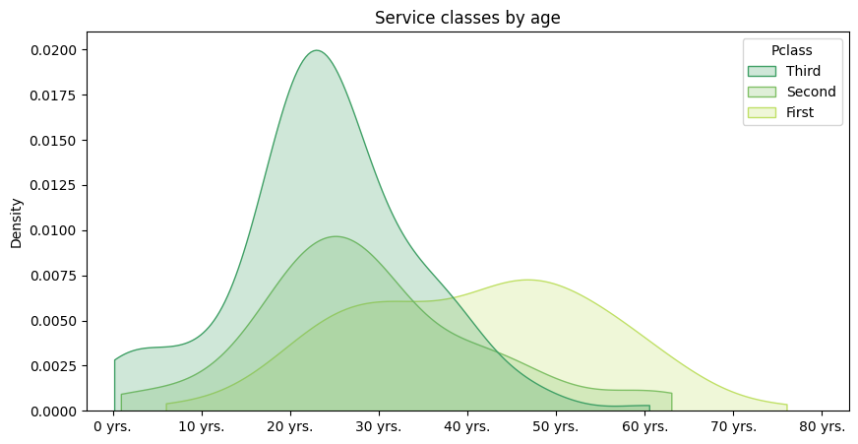
Overlapping density plot

Slide 51
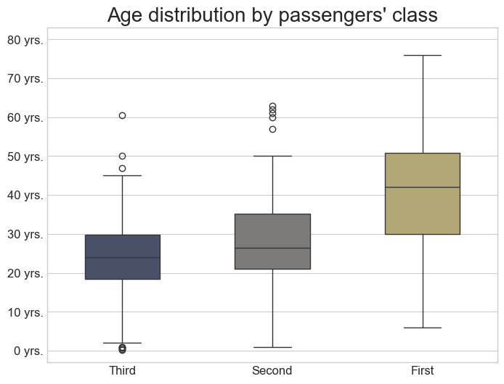
Box plots

Slide 52
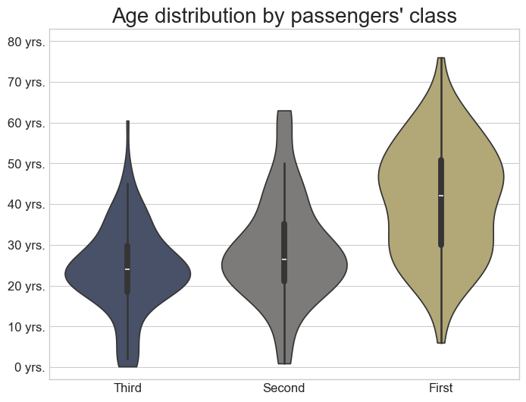
Violin plot

Slide 53
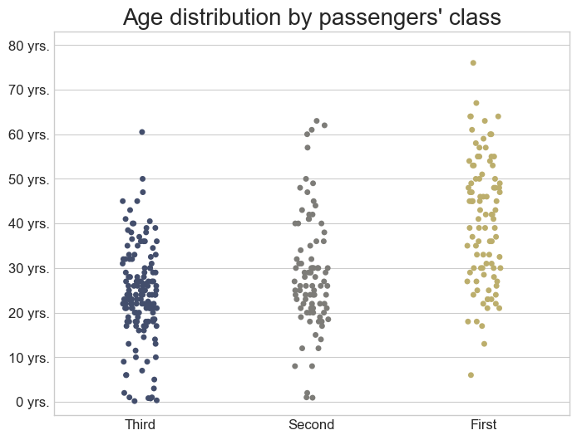
Strip plot

Slide 54
Logarithmic scale

Slide 55
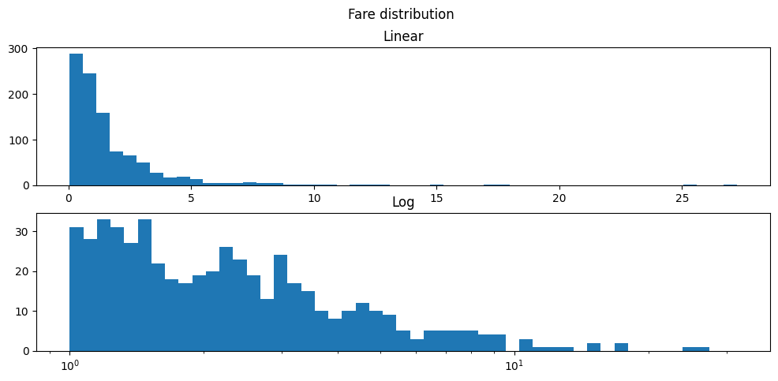
Logarithmic scale

Slide 56
Real vs theoretical distribution

Slide 57
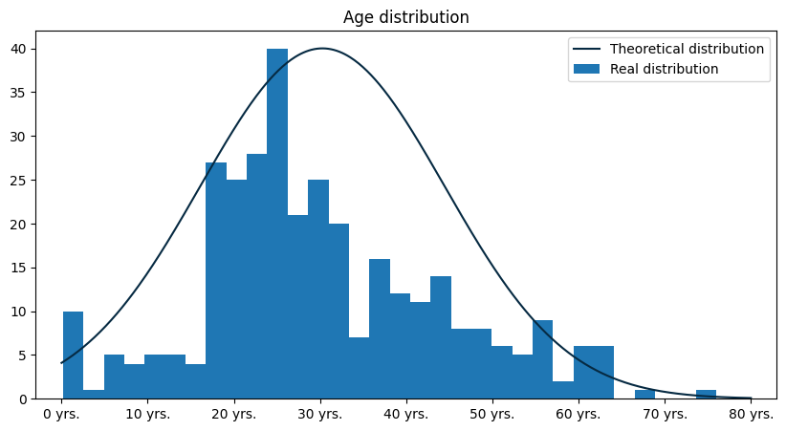
Real vs theoretical distribution

Slide 58
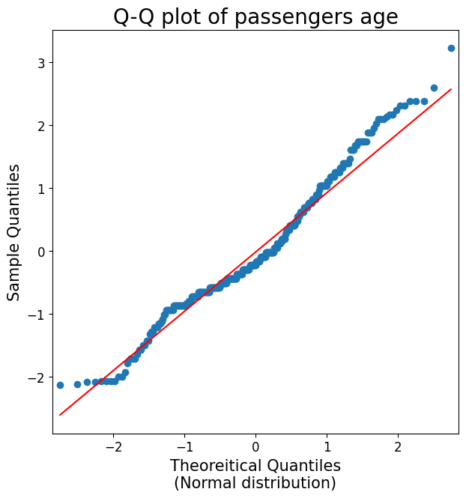
Real vs theoretical distribution

Slide 59
Frequently made mistakes

Slide 60
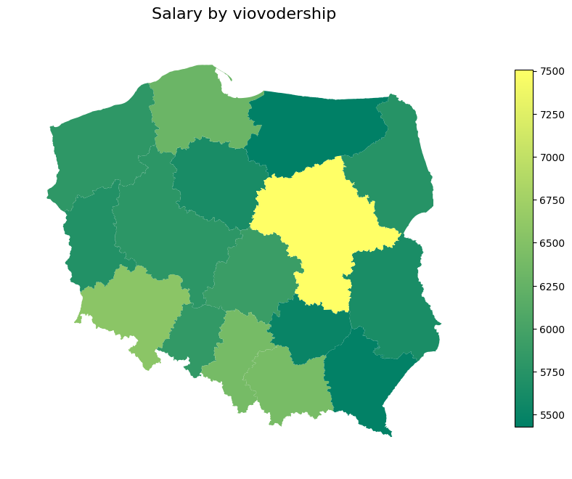
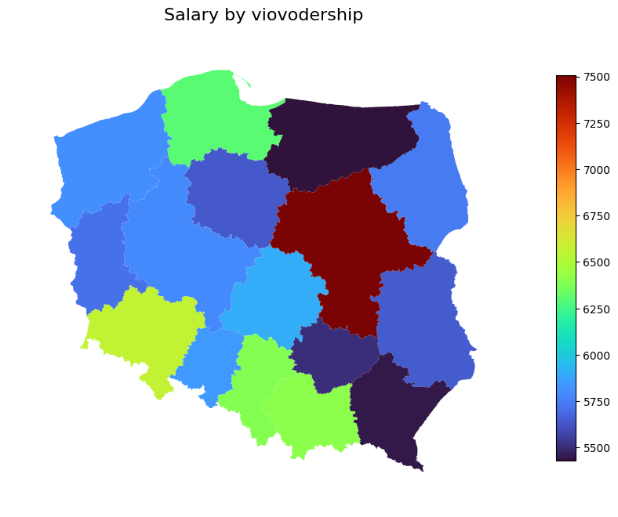
Incorrect color scale

Slide 61
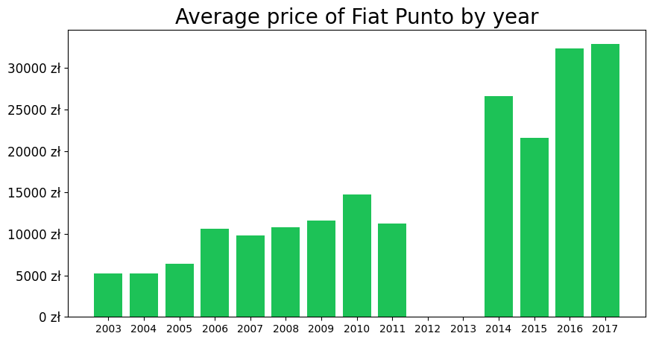
Informing about missing data

Slide 62
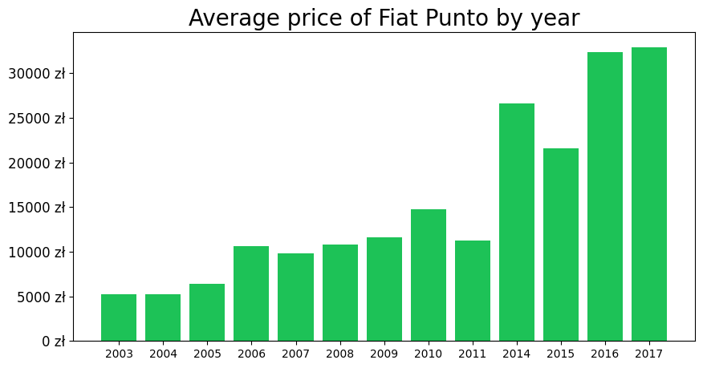
Informing about missing data

Slide 63
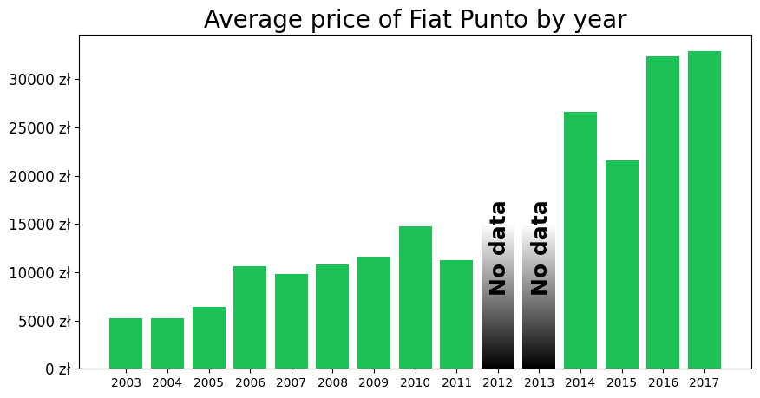
Informing about missing data

Slide 64
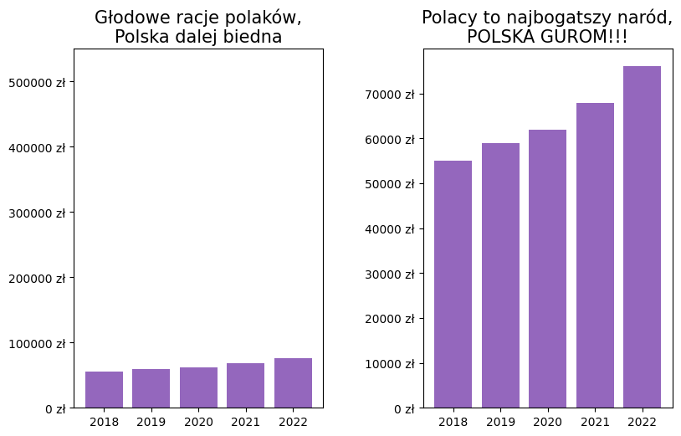
Manipulating scale

Slide 65
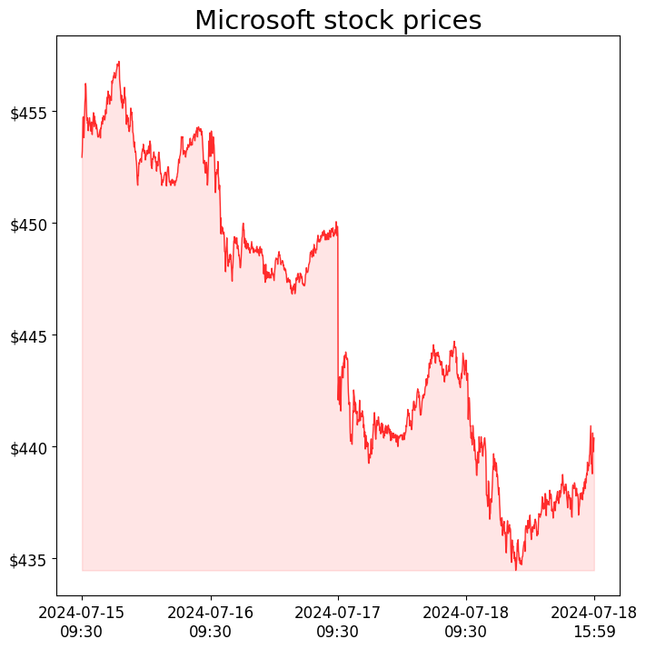
Manipulating scale

Slide 66
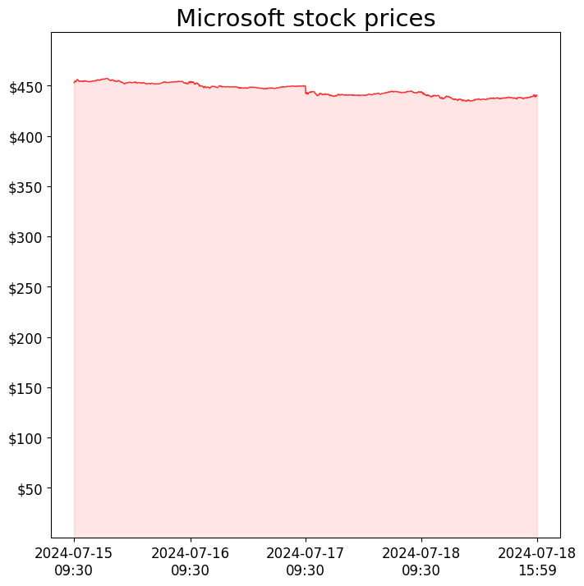
Manipulating scale

Slide 67
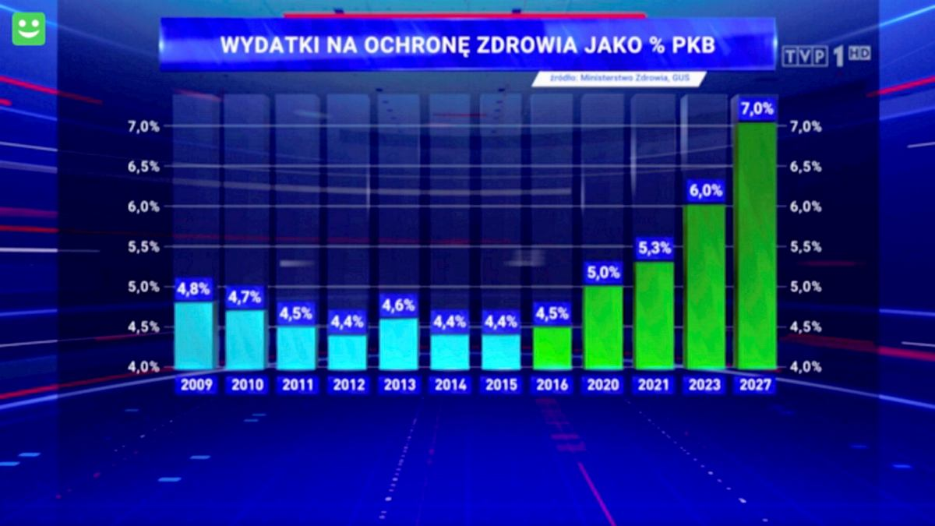
Manipulating scale

Slide 68
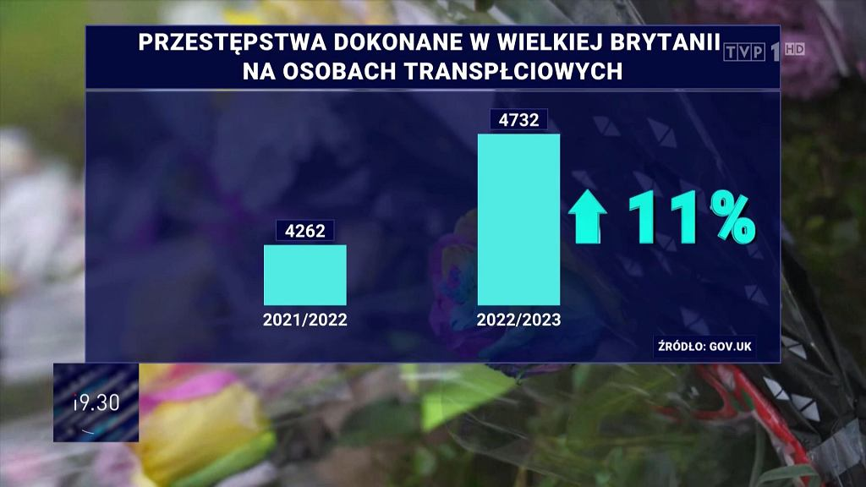
Manipulating scale

Slide 69
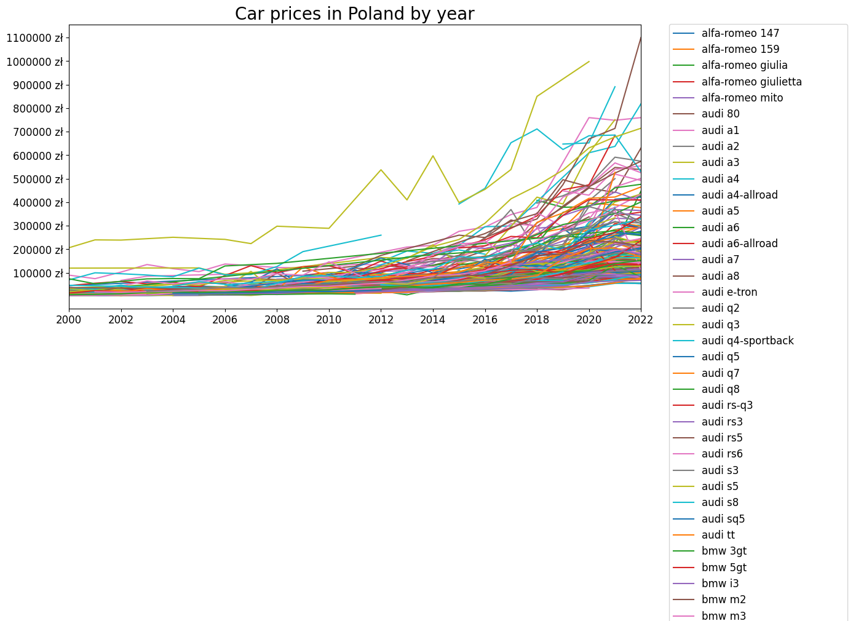
Too many informations

Slide 70
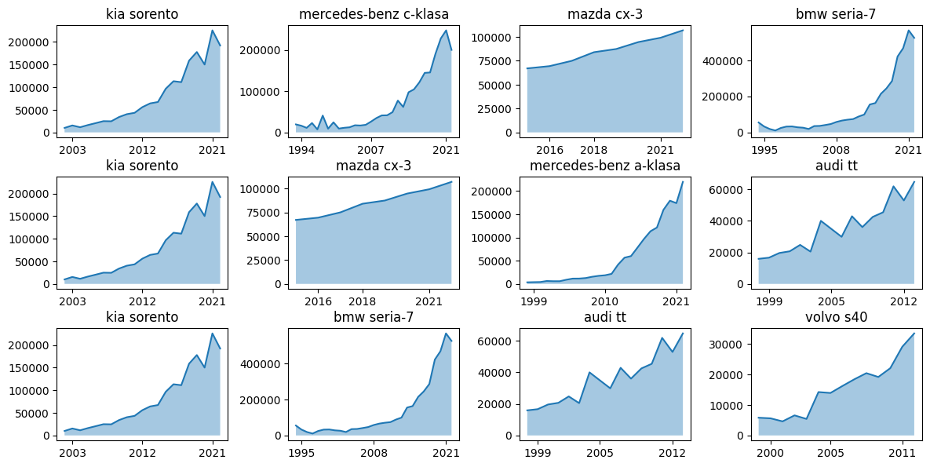
Too many informations

Slide 71
References
https://github.com/Skamlo/Visualization-Techniques-in-Python
https://towardsdatascience.com/kernel-density-estimation-explained-step-by-step-7cc5b5bc4517
https://www.kaggle.com/datasets/brendan45774/test-file
https://stat.gov.pl/sygnalne/komunikaty-i-obwieszczenia/lista-komunikatow-i-obwieszczen/obwieszczenie-w-sprawie-wysokosci-przecietnego-miesiecznego-wynagrodzenia-brutto-w-gospodarce-narodowej-w-wojewodztwach-w-2022-roku,295,9.html
https://www.zus.pl/baza-wiedzy/skladki-wskazniki-odsetki/wskazniki/przecietne-wynagrodzenie-w-latach
https://www.kaggle.com/datasets/aleksandrglotov/car-prices-poland
https://towardsdatascience.com/kernel-density-estimation-explained-step-by-step-7cc5b5bc4517
https://www.youtube.com/watch?v=cy8r7WSuT1I

